Slide 1
Index Number
Md. Ismail Hossain Riday

Slide 2
Index number
Economists like to compare information from different time periods to understand how things change over time.
For example, they might want to see if prices are going up or down over the years, or if people's incomes are increasing.
Imagine a big-picture economist who wants to see how expensive it is for people to live in Bangladesh over five years. They're interested in whether things are getting more or less expensive for people there.
Index number allow for quick and easy comparisons by identifying a 'base year' and scaling all of the other results off of that year.

Slide 3
Index number
Index number can be defined as the number
Indicates relative changes
Price, Quantity, or Value of commodities
Due to change in time or place

Slide 4
Types
Three types of index numbers
Price index number
Quantity index number
Value index number
Relative change is commodity price due to change of time
Relative change is commodity quantity due to change of time
Relative change is commodity value due to change of time

Slide 5
Characteristics
It is free from unit
It is always expressed in percentage
It compares the change in variable or a group of variables at different times or at different places

Slide 6
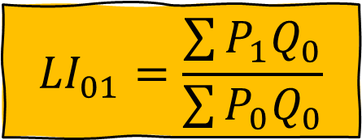
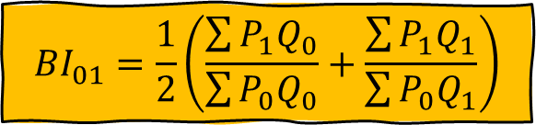

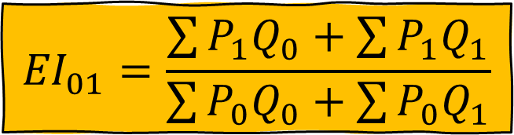


Price Index Number
$$I_{01}=\frac{\sum{P_{1}}}{\sum{P_{0}}}×100$$
Simple Aggregate Method
Weighted Aggregate Method
$${LI}_{01}=\frac{\sum{P_{1}Q_{0}}}{\sum{P_{0}Q_{0}}}$$
Laspeyres's formula
$${PI}_{01}=\frac{\sum{P_{1}Q_{1}}}{\sum{P_{0}Q_{1}}}$$
Paasche's Formula
$${EI}_{01}=\frac{\sum{P_{1}Q_{0}+\sum{P_{1}Q_{1}}}}{\sum{P_{0}Q_{0}}+\sum{P_{0}Q_{1}}}$$
Edgworth-Marshall’s
$${BI}_{01}=\frac{1}{2}\left(\frac{\sum{P_{1}Q_{0}}}{\sum{P_{0}Q_{0}}}+\frac{\sum{P_{1}Q_{1}}}{\sum{P_{0}Q_{1}}}\right)$$
Dorbish-Bowley’s
Fisher’s Ideal
$${FI}_{01}=\sqrt{LI_{01}×P_{01}}$$

Slide 7



Math
Find the index number using…
$$LI_{01}=116.99\%$$
$$PI_{01}=116.95\%$$
$$FI_{01}=116.97\%$$
Consumption of different item by a certain family in 1985 and 1995 along with the corresponding price are given below:
Item | 1985 |  | 1995
 | Price(Tk/Kg) | Quantity (kg) | Price(Tk/kg) | Quantity(kg)
Rice | 11 | 25 | 13 | 20
Wheat | 8 | 12 | 10 | 15
Pulses | 22 | 3 | 25 | 4
Oil | 35 | 4 | 40 | 5
Sugar | 25 | 4 | 28 | 5

Slide 8
Interpretation
The price index of 116% indicates that prices have increased by 16% since the base year of 1985.
In other words, on average, the cost of goods and services in 1995 is 16% higher than it was in 1985.
This means that if something cost BDT100 in 1985, it would now cost BDT116 in 1995 to buy the same thing.

Slide 9
Self Practice
 | Year | 2013 | 2014 | 2015 | 2016 | 2017 | 2018 | 2019
Item 1 | Price | 56 | 58 | 60 | 65 | 68 | 81 | 83
 | Quantity | 25 | 30 | 20 | 35 | 28 | 32 | 22
Item 2 | Price | 49 | 54 | 58 | 66 | 68 | 72 | 75
 | Quantity | 18 | 23 | 15 | 29 | 21 | 27 | 16
Item 3 | Price | 70 | 72 | 74 | 73 | 75 | 78 | 80
 | Quantity | 22 | 27 | 19 | 33 | 25 | 31 | 20
a) Use the three-year moving average method to discover and illustrate the trend in the price of "Item 1".
c) Apply the best price index number method, and determine the index number for the year 2019 with the base year set as 2018.
b) Fit linear trend model to the data (price of item 2) using least squares estimation.

Slide 10
Thank You

